Slide 1

Beginner Vue Training

Slide 2
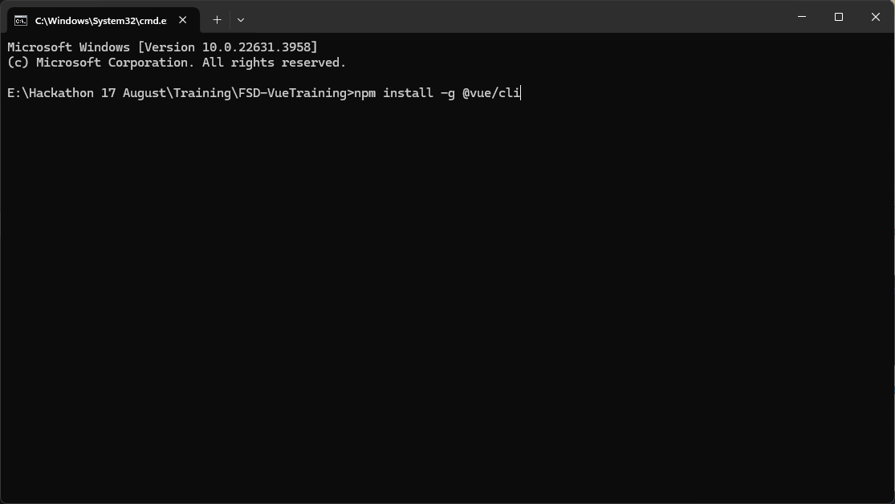
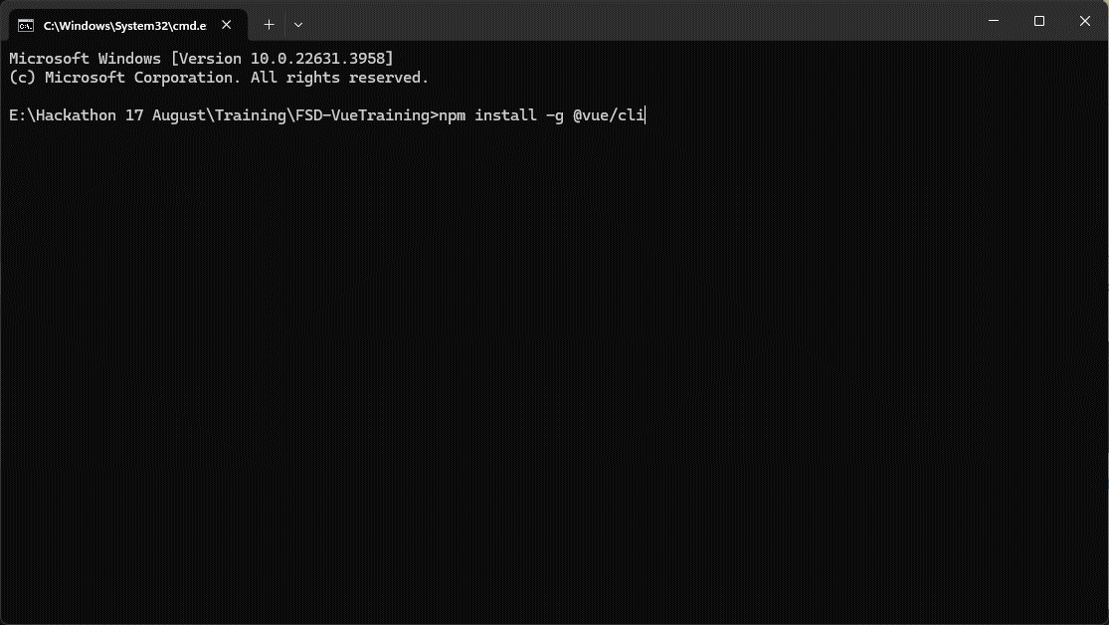
0a – Installing Vue

Slide 3
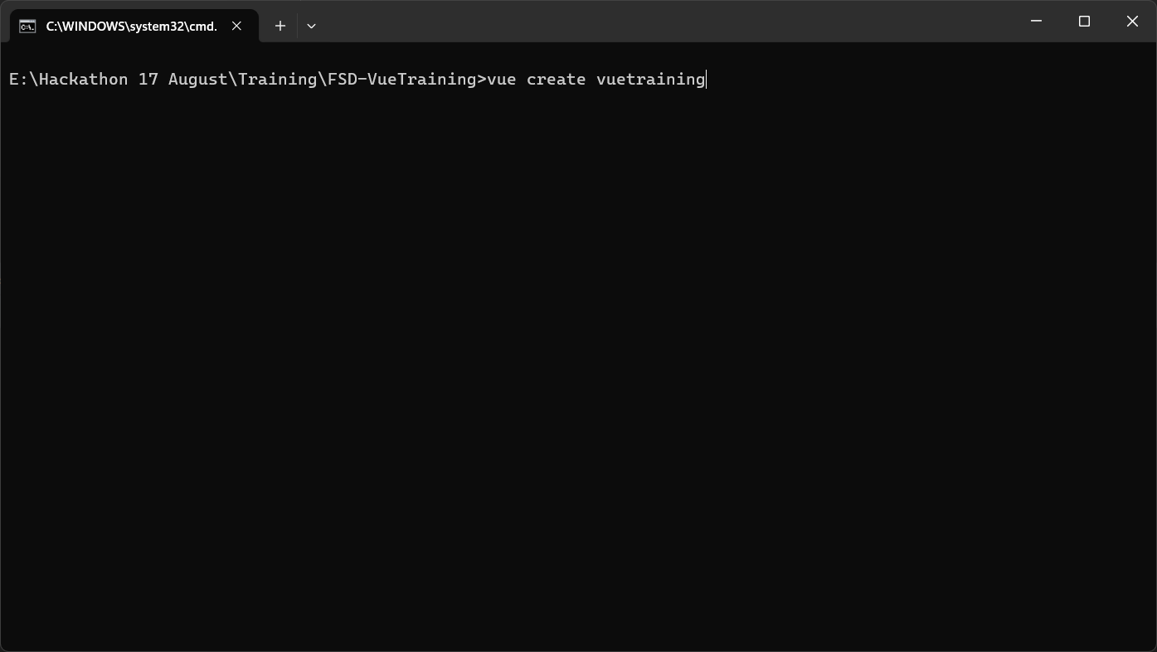
0b – Initializing the project

Slide 4
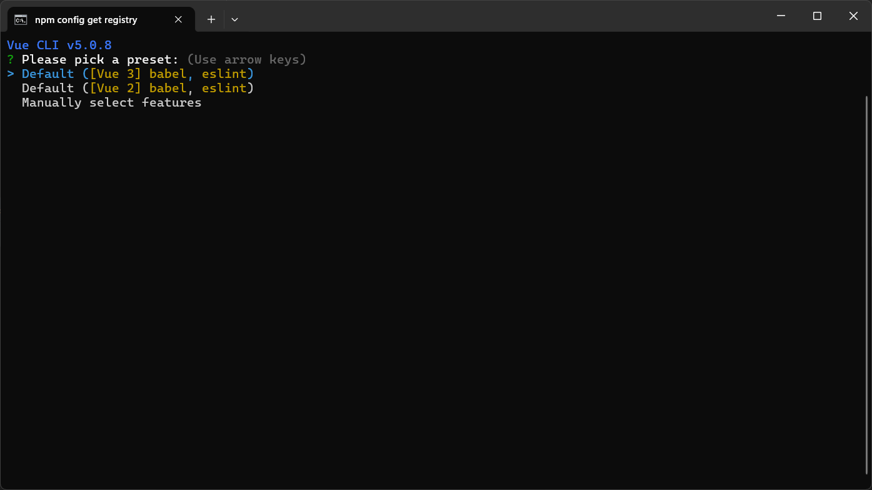
0c – Selecting Latest Version

Slide 5

0d – Run npm Install

Slide 6
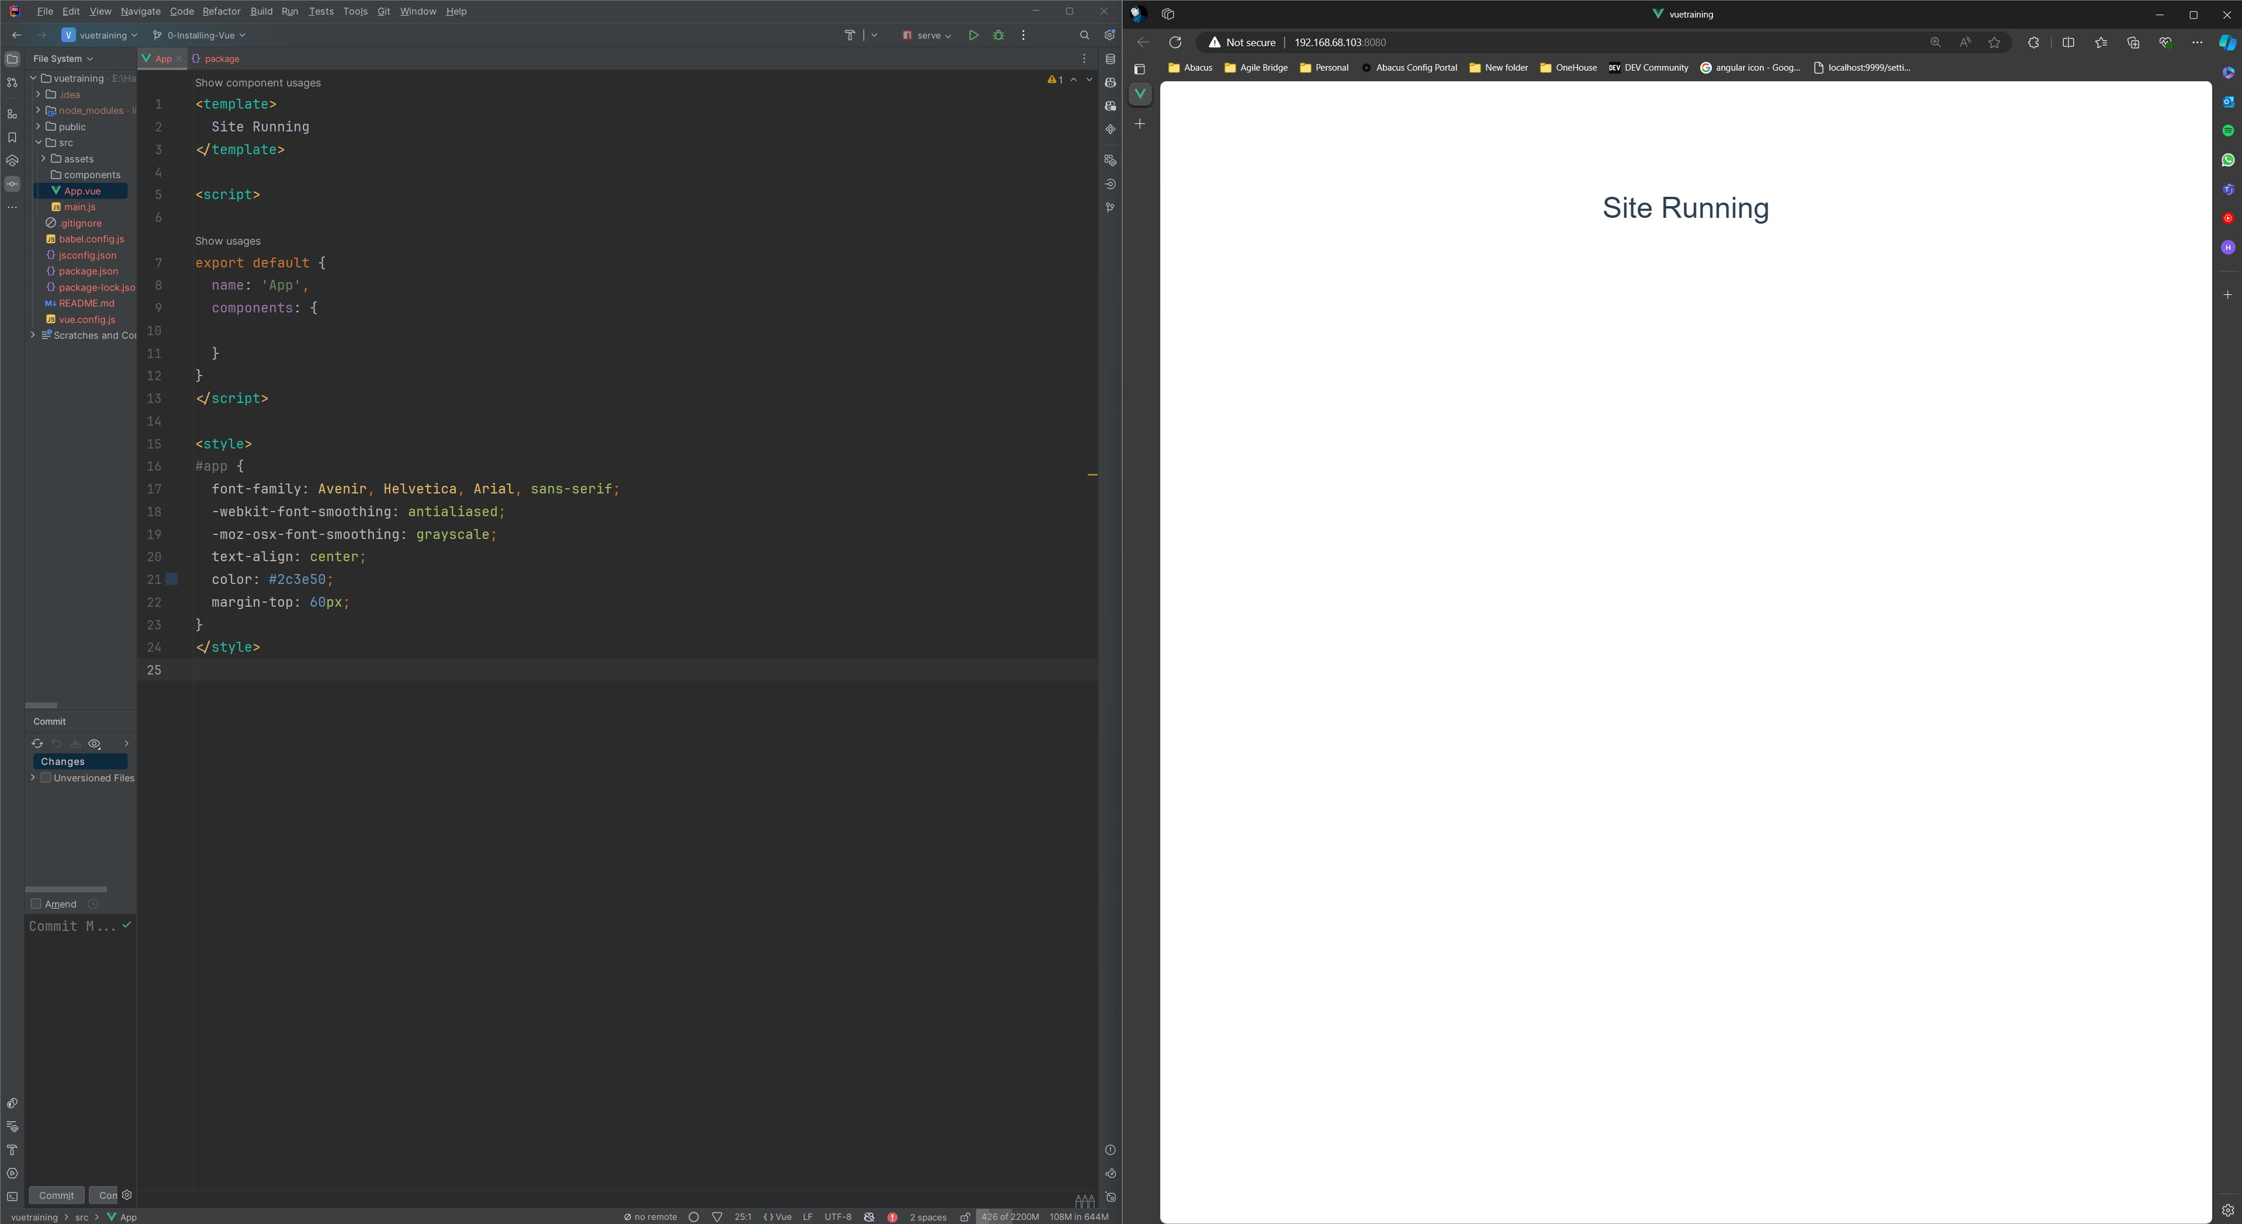
0e – The site up and running

Slide 7
Templating

Slide 8
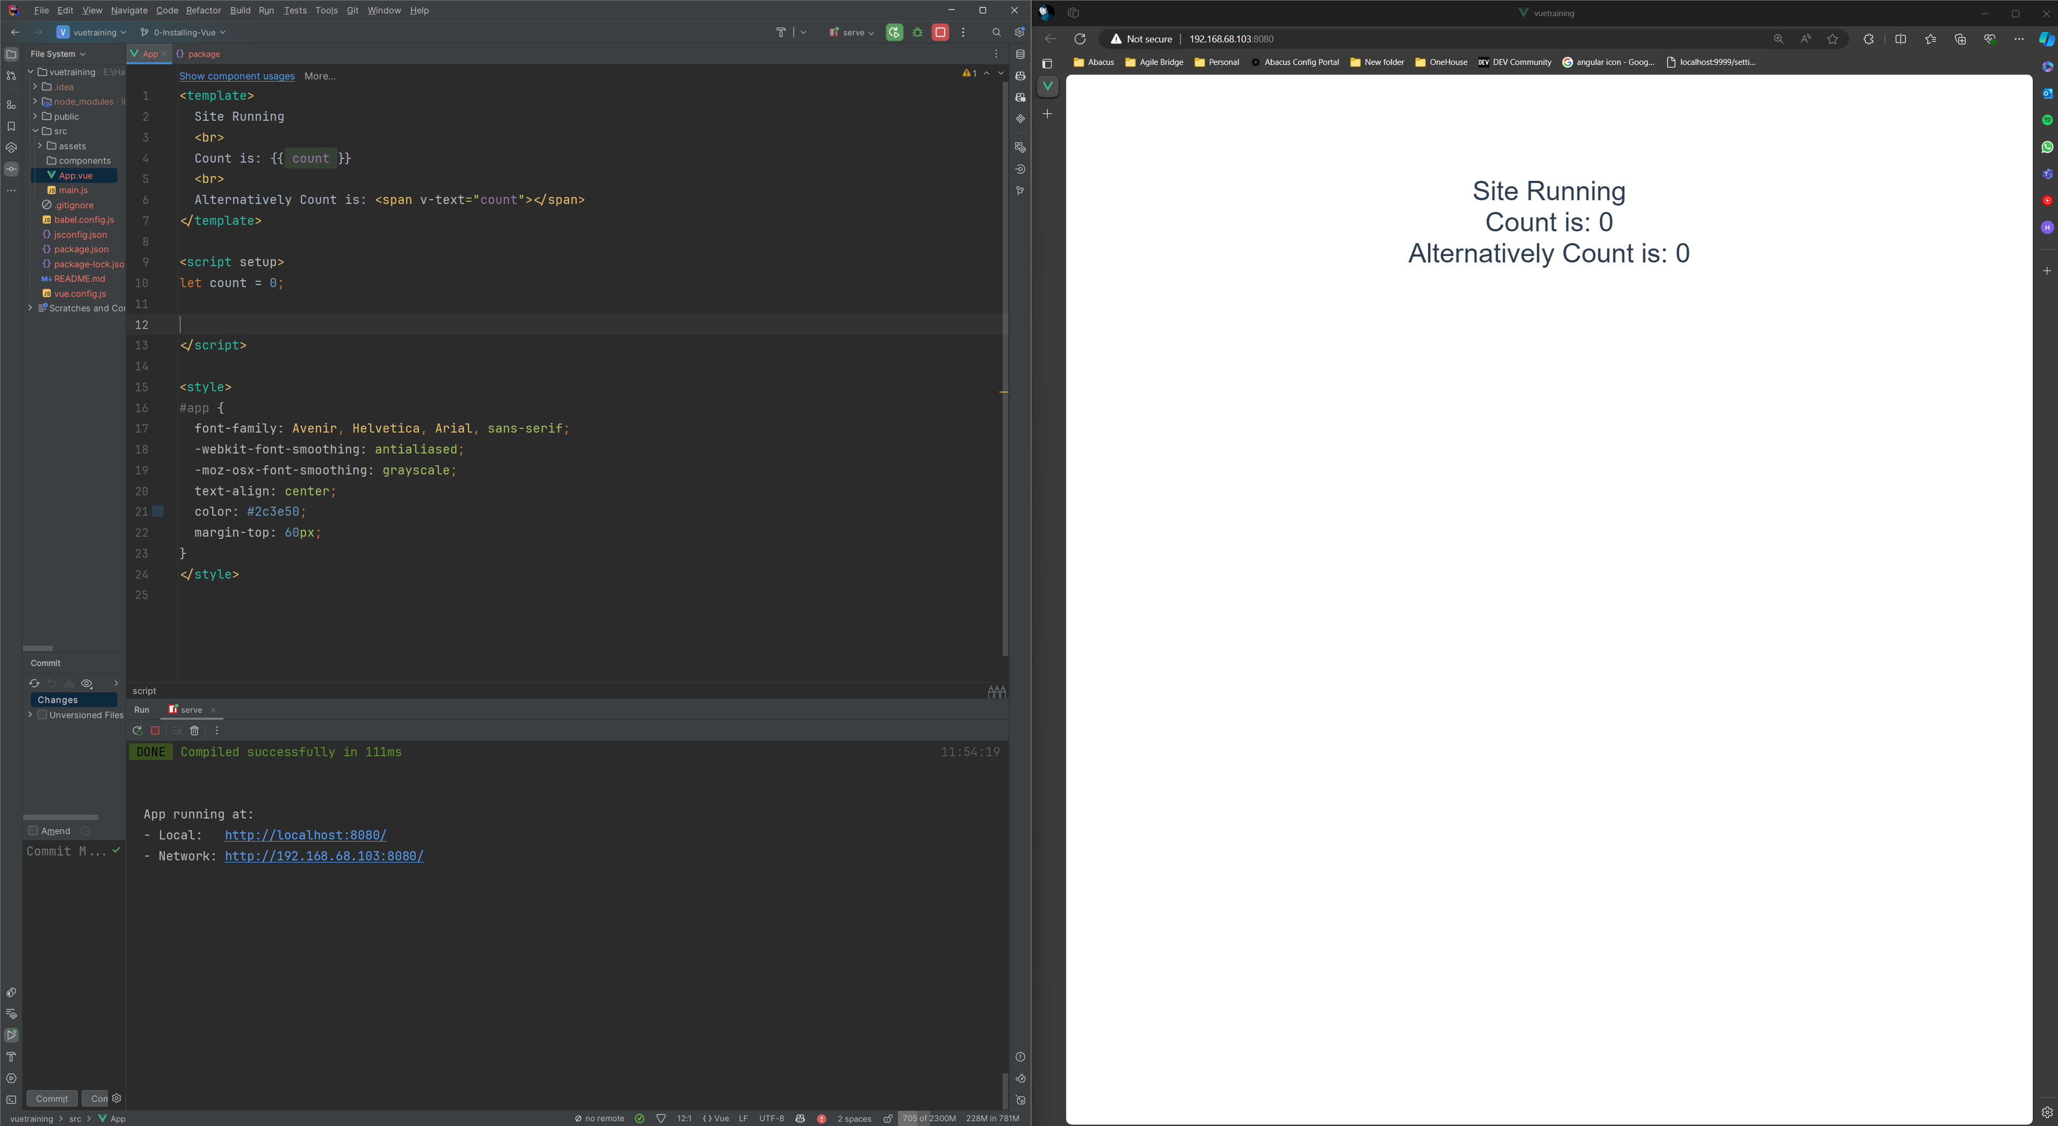
1a. One Way Bound Data

Slide 9
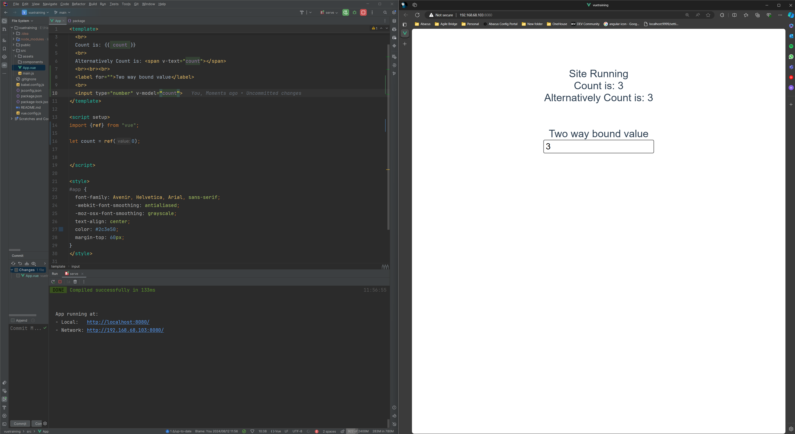
1b. Two Way Bound Data

Slide 10
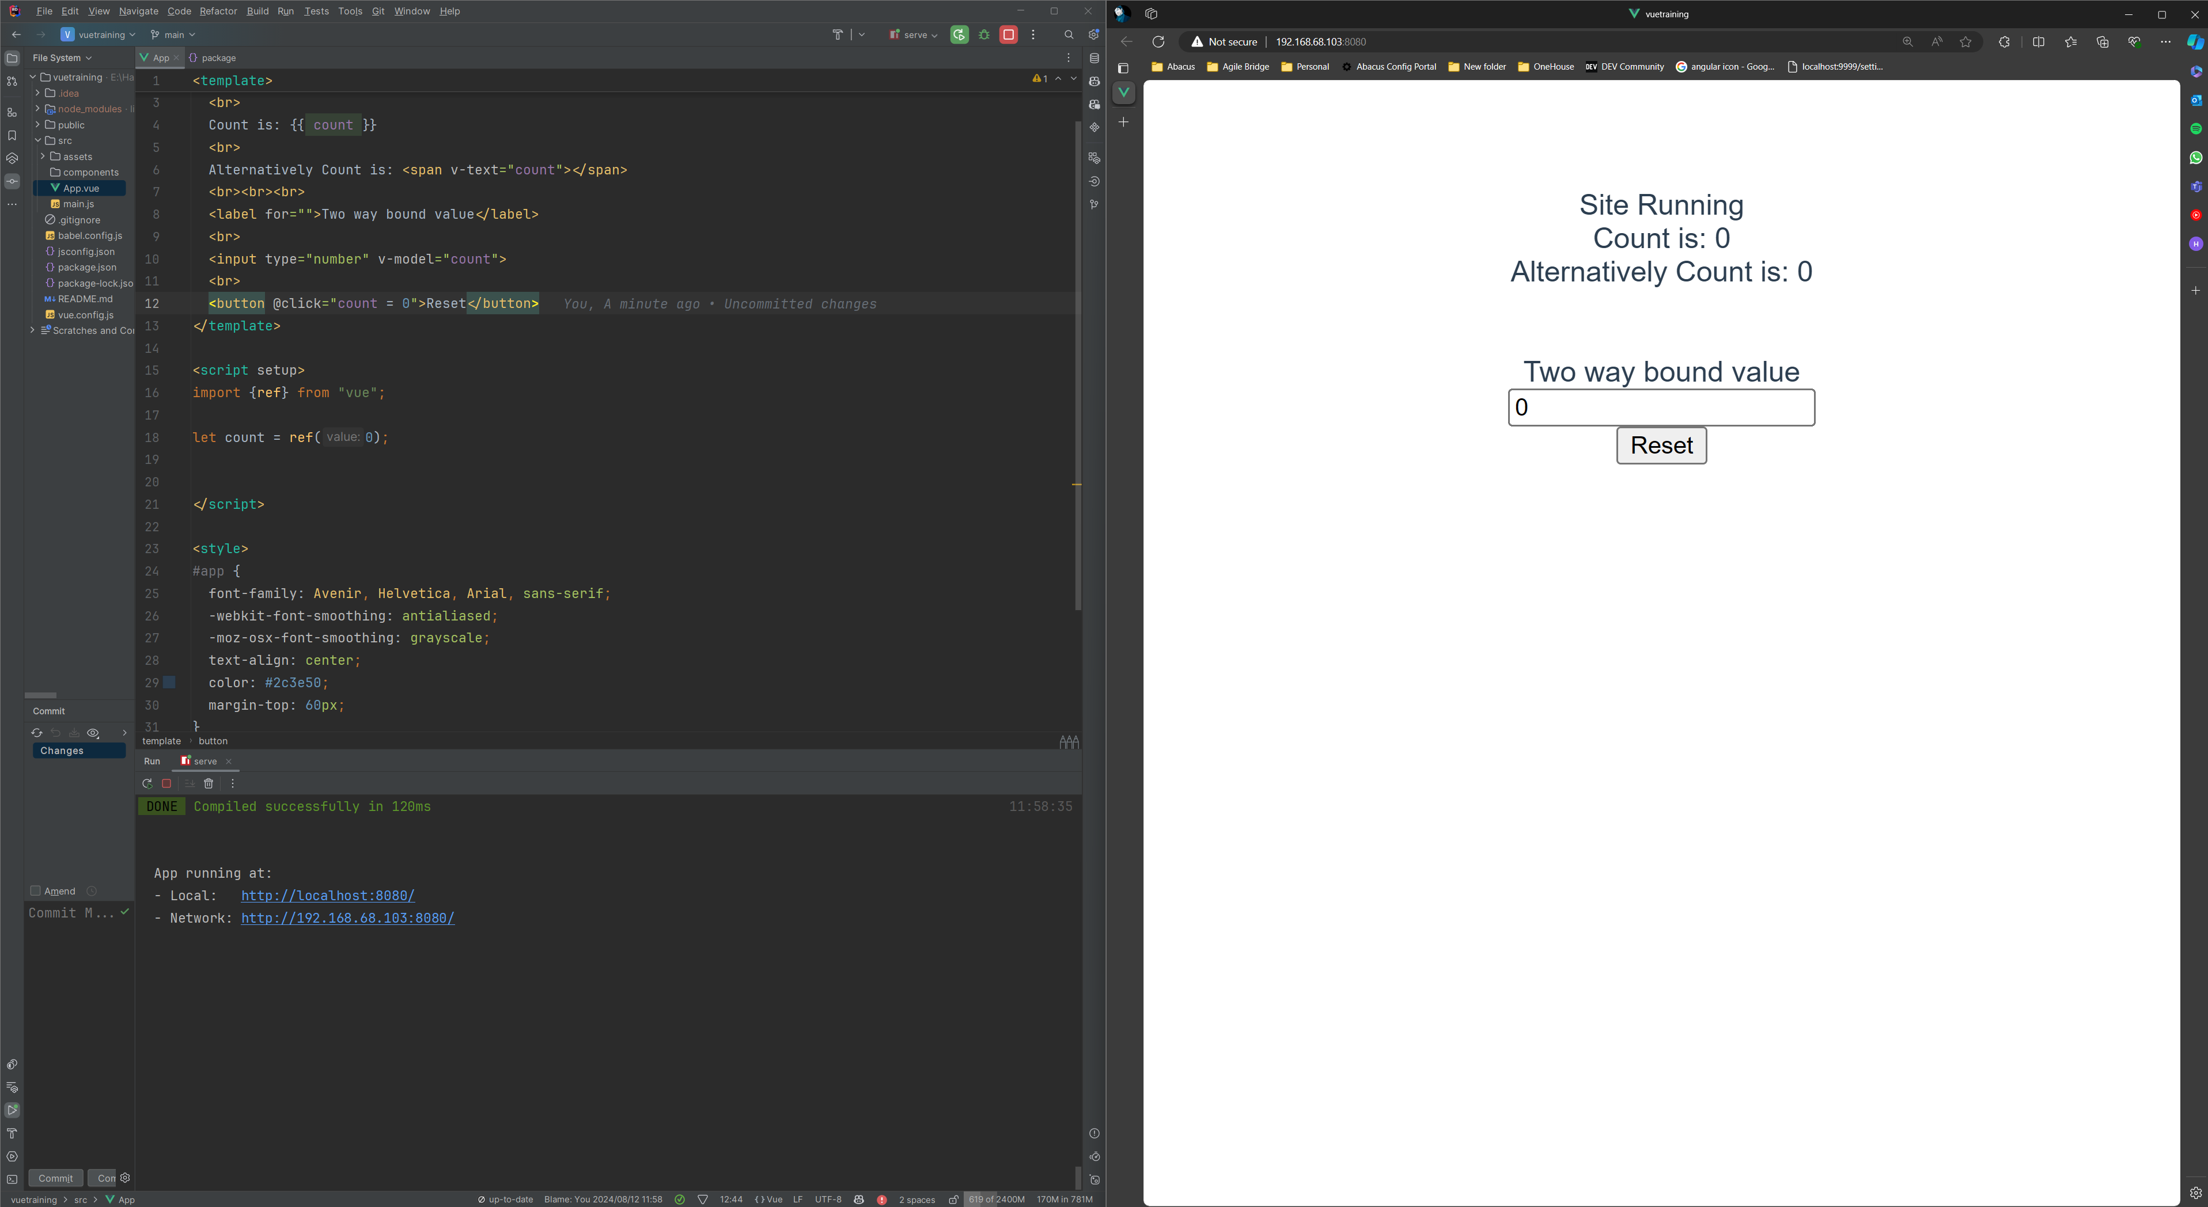
1c. Event handling

Slide 11
Componentization

Slide 12
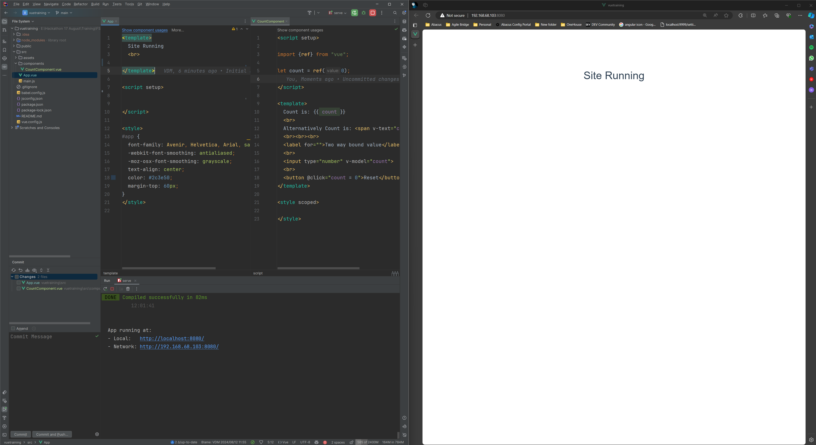
2a. Creating a component

Slide 13
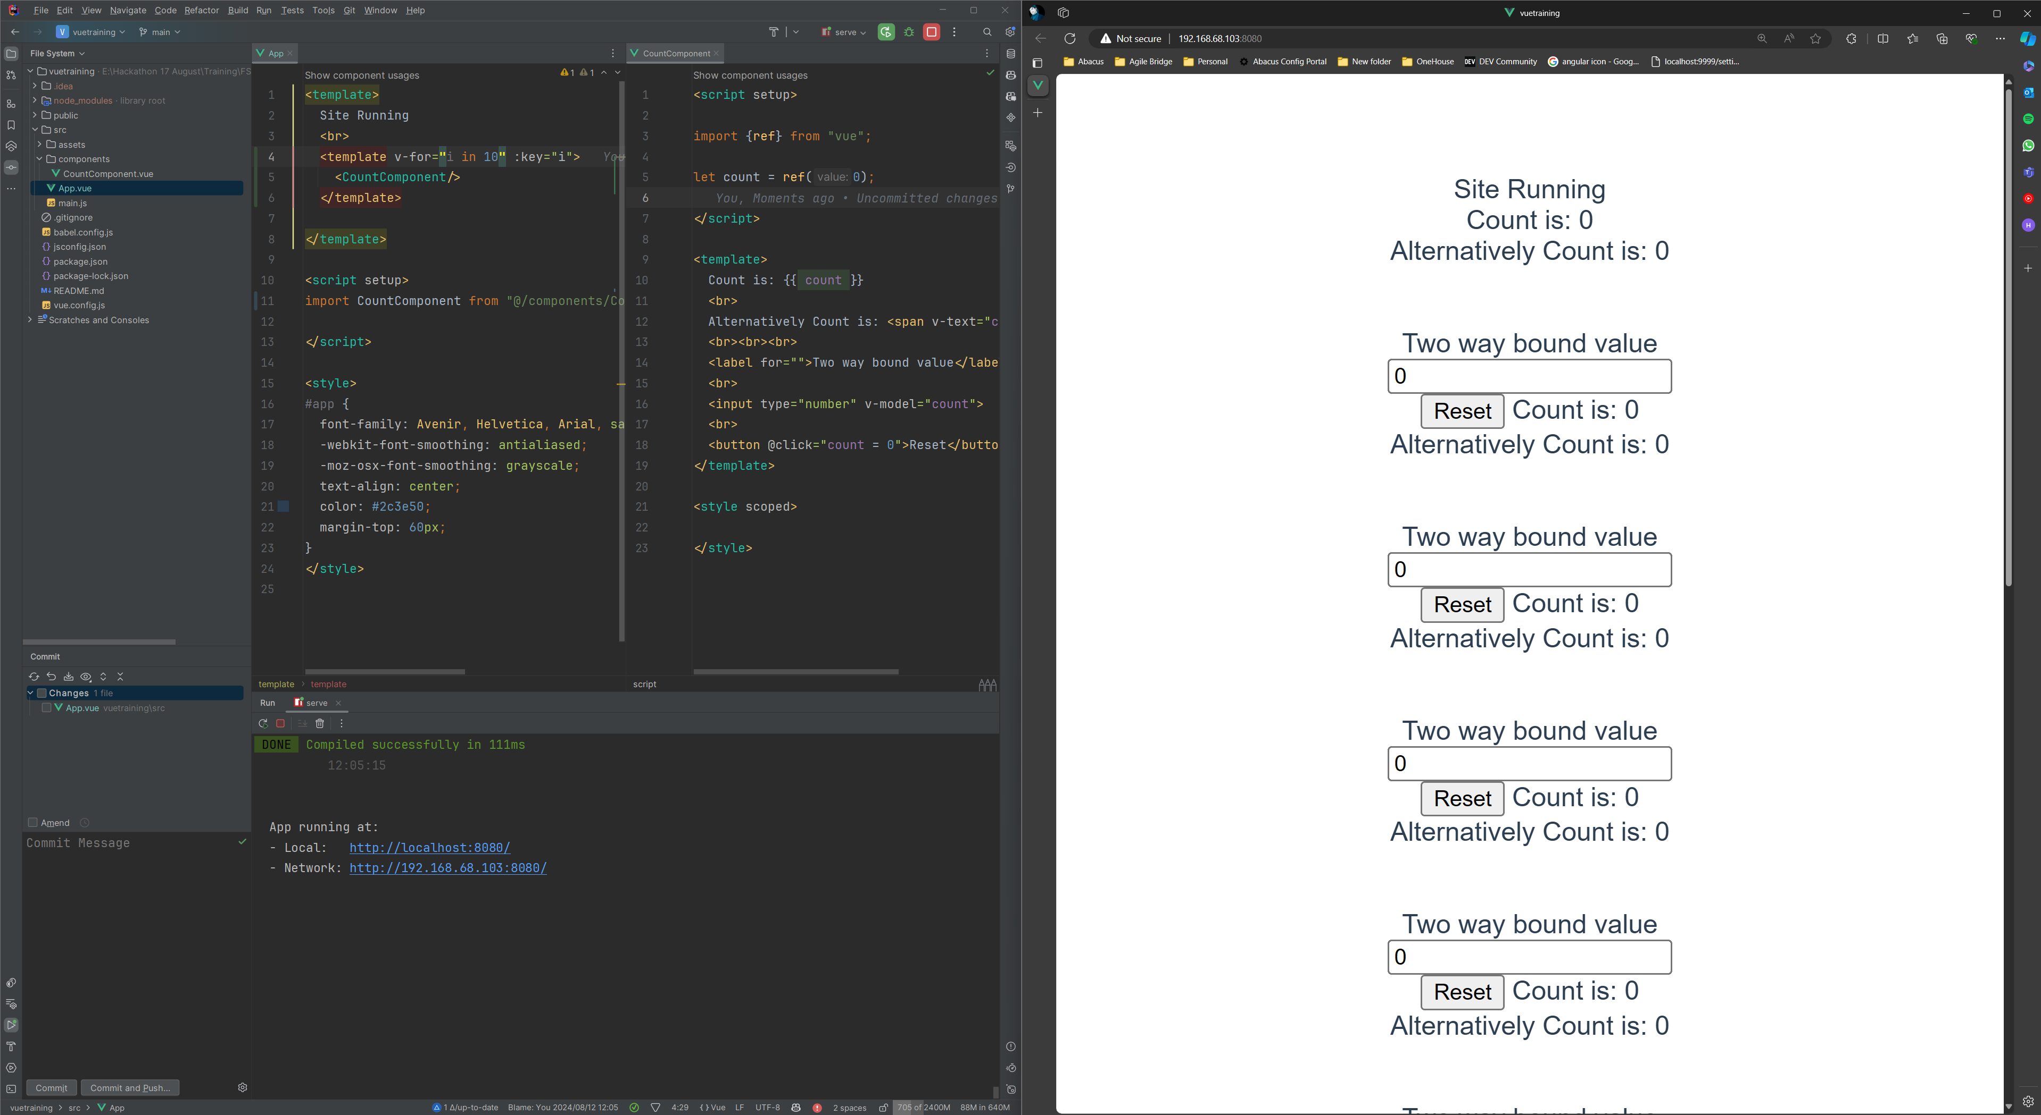
2b. Using the component

Slide 14
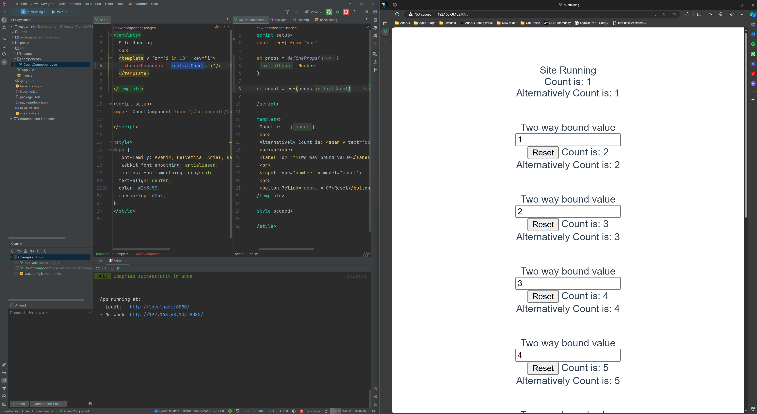
2c. Passing Data (props) to components

Slide 15
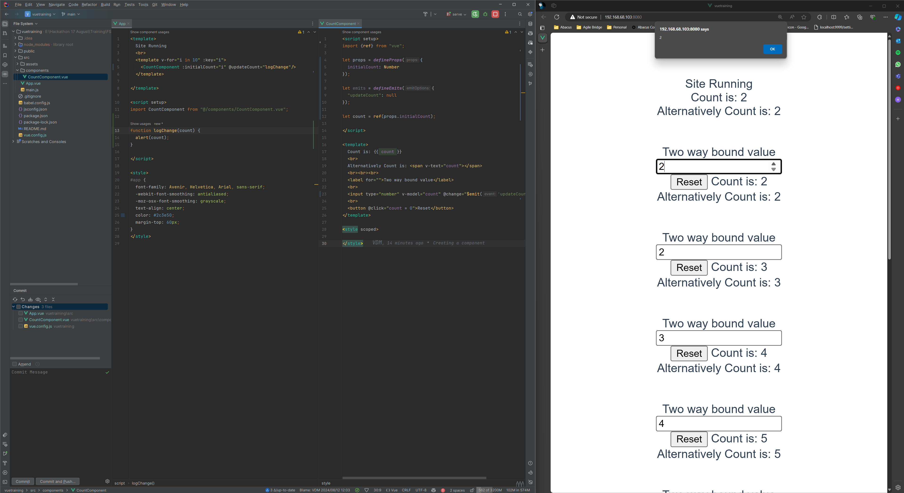
2d. Emitting Changes

Slide 16
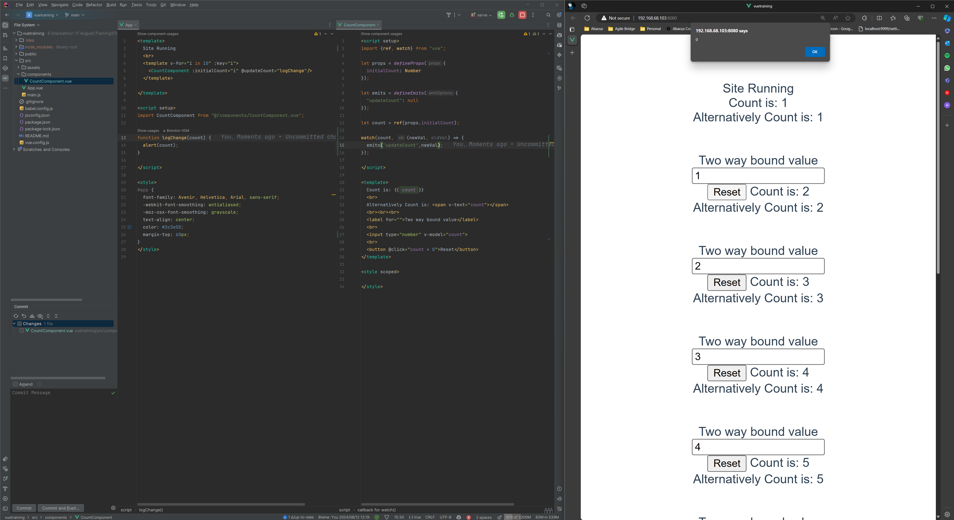
2e. Watching Changes

Slide 17
Life Cycles

Slide 18
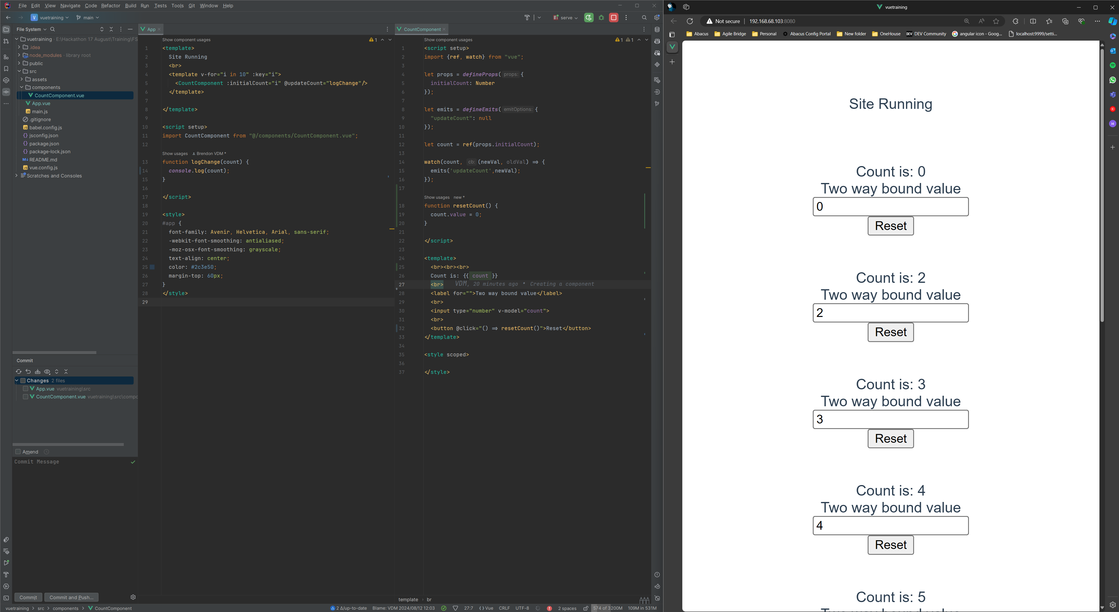
3a. Manually triggered Functions

Slide 19
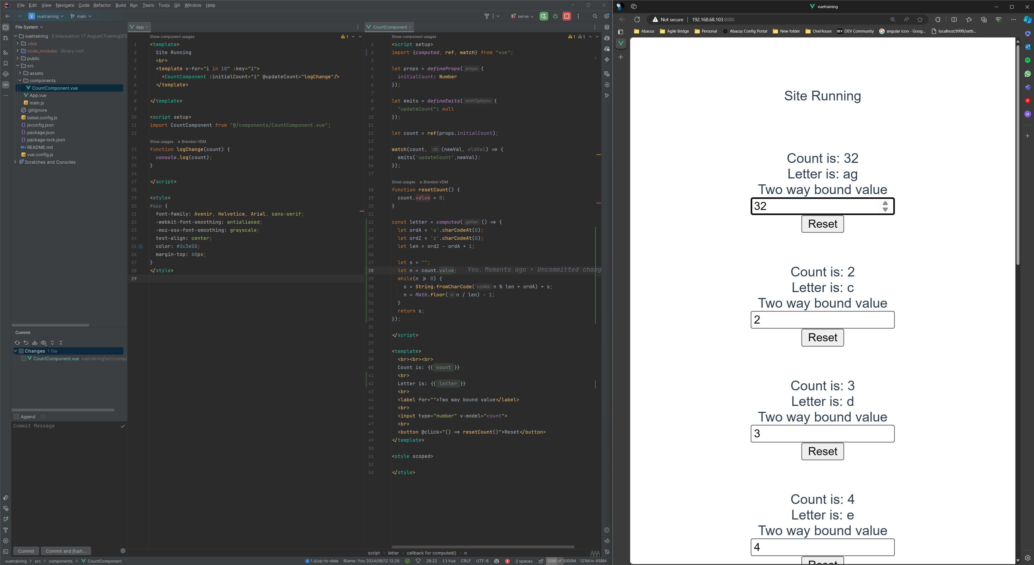
3b. Computed Functions

Slide 20
Routing

Slide 21
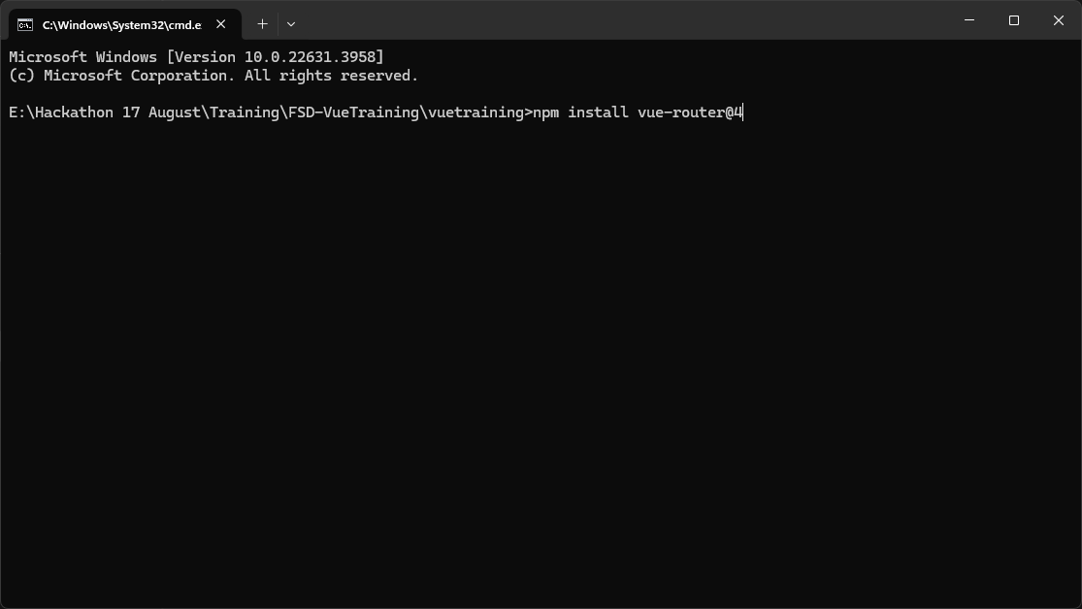
4a. Install Router

Slide 22
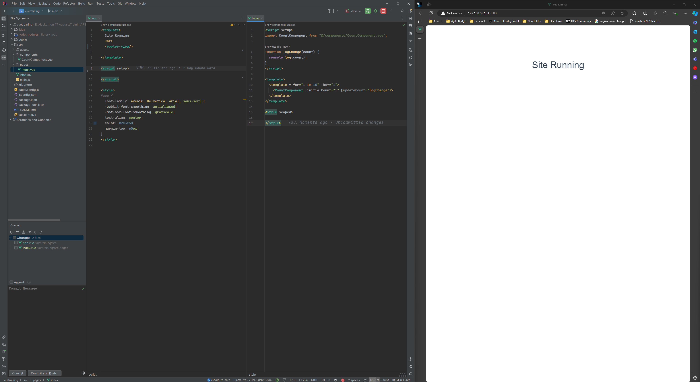
4b. Setting up App and Index Page

Slide 23
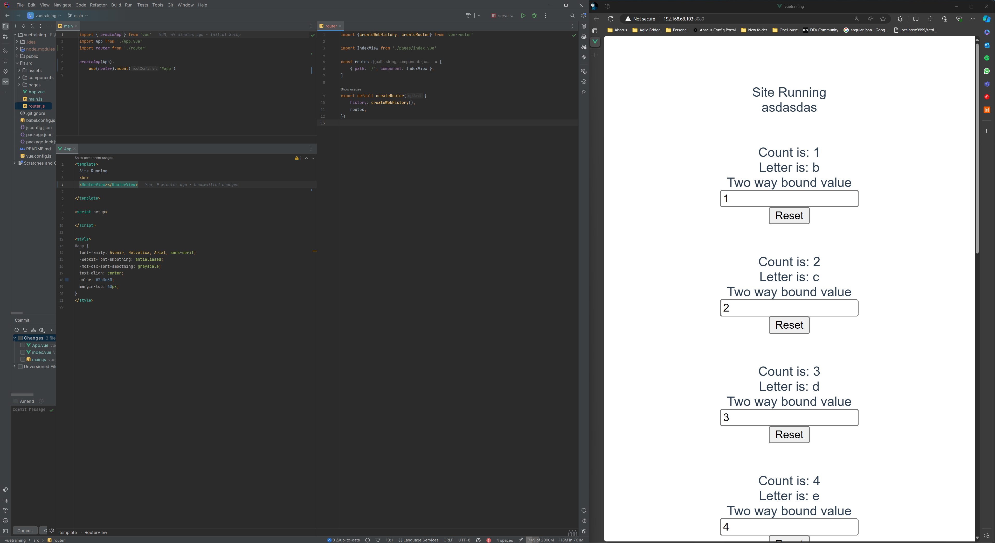
4c. Setting Up Router Config

Slide 24
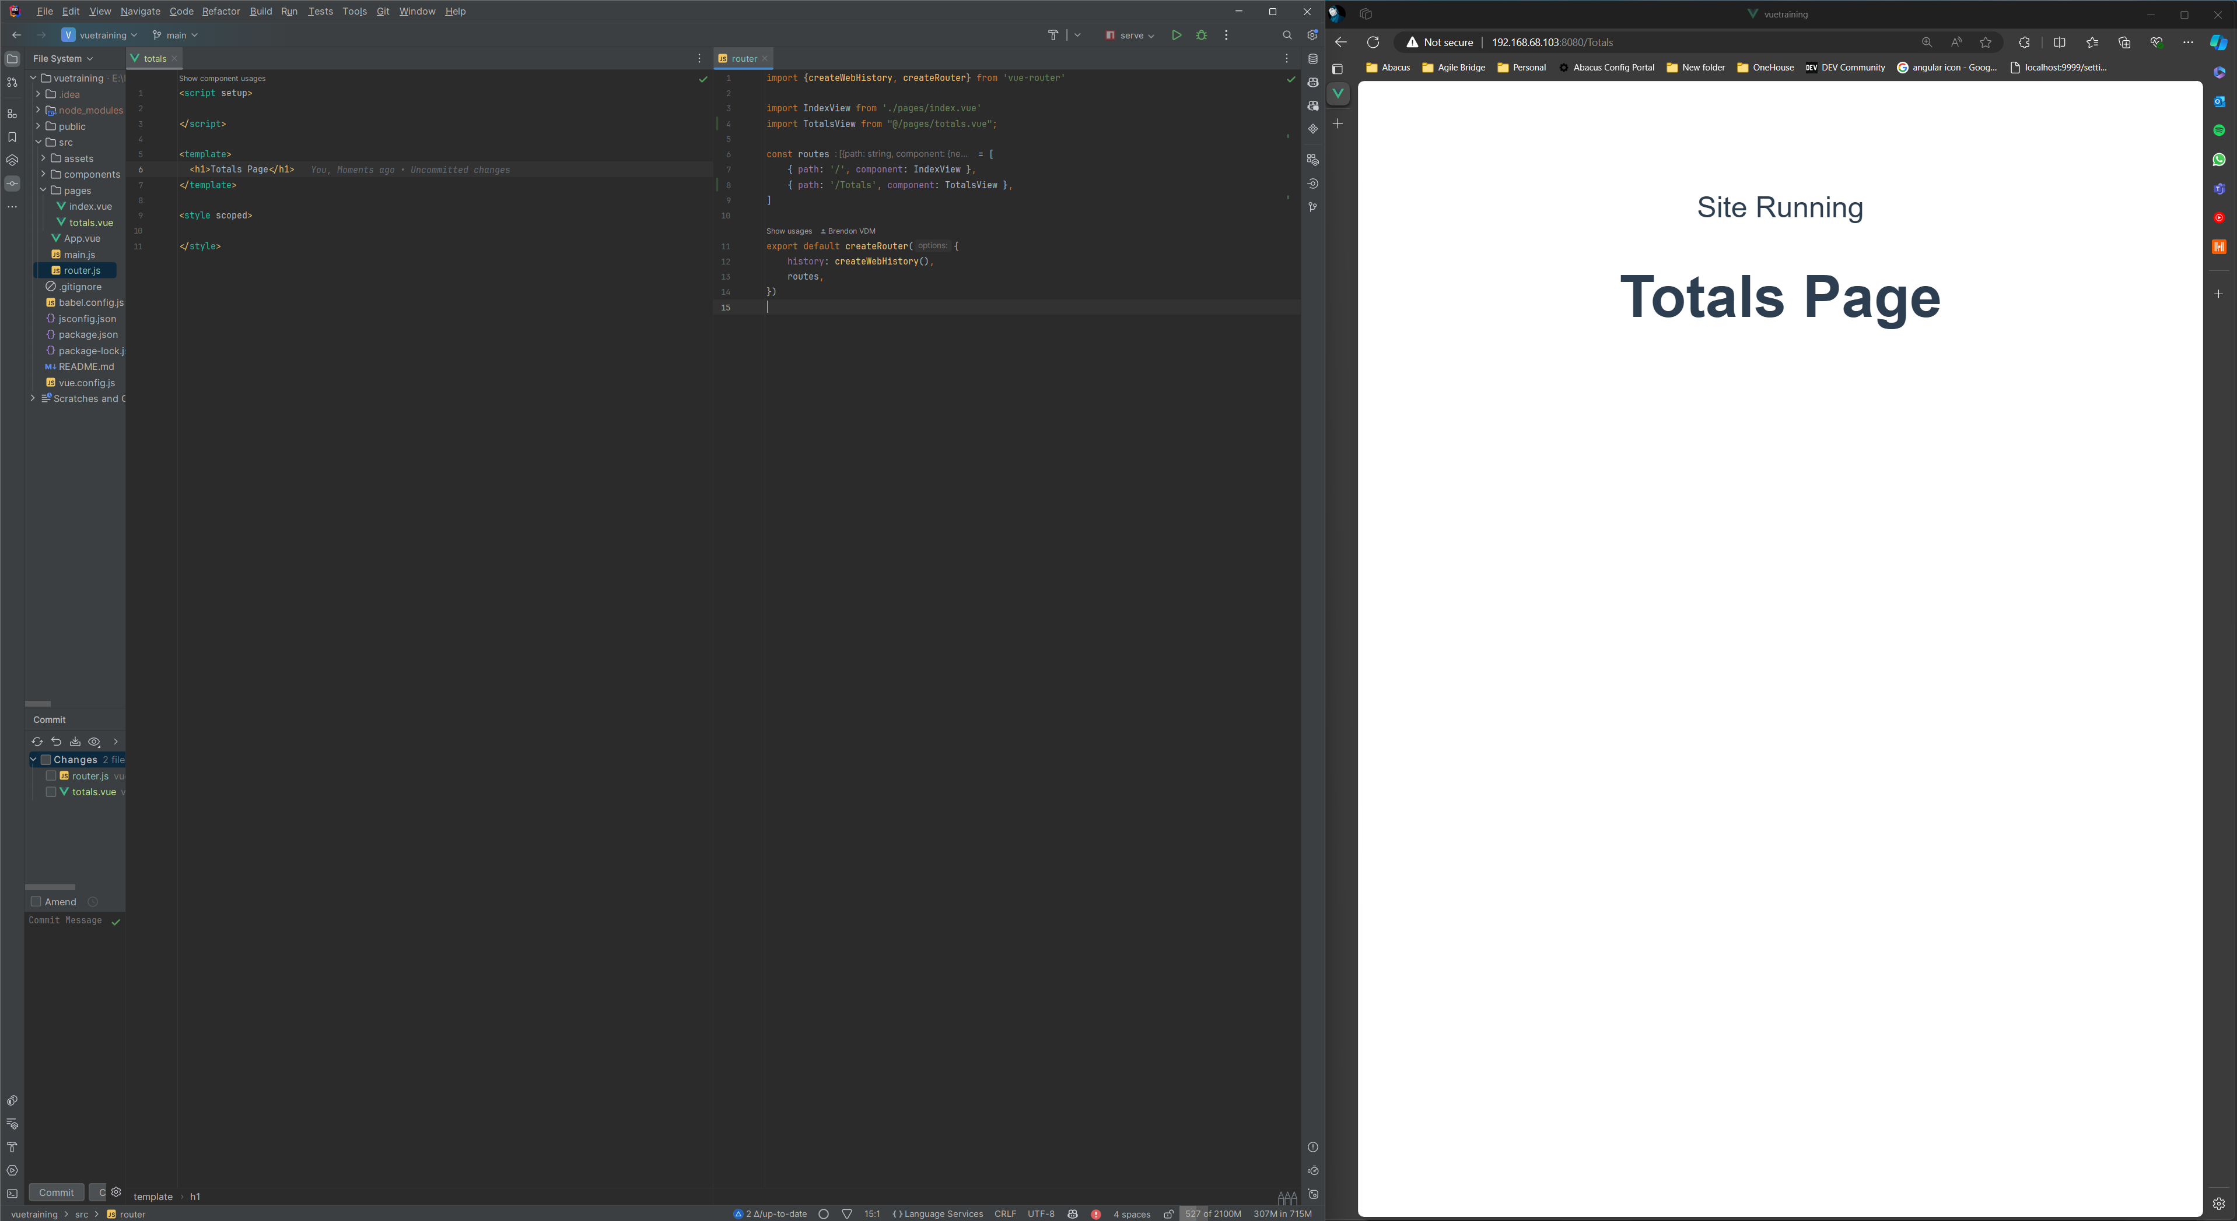
4d. Creating a new Page

Slide 25
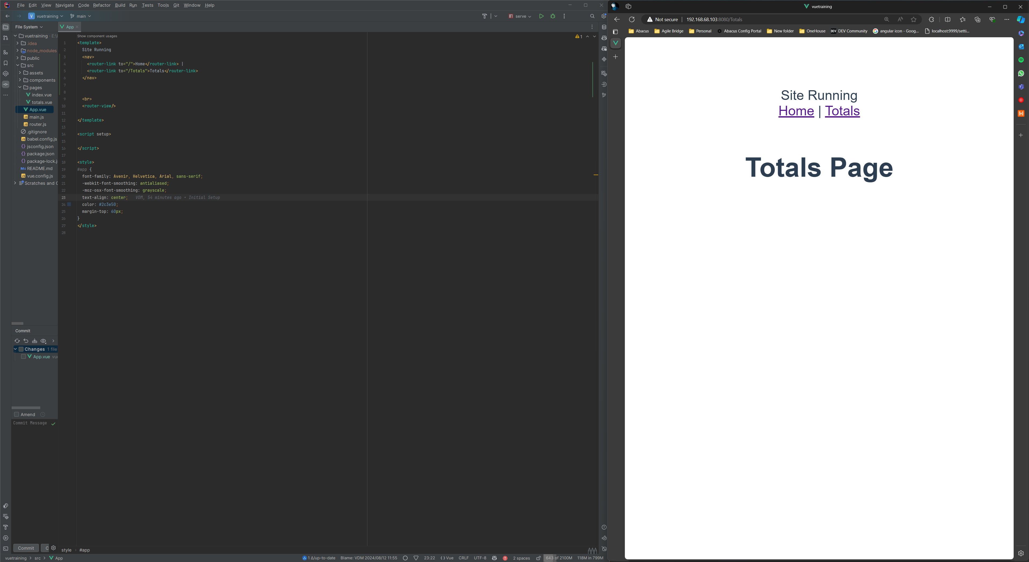
4e. Navigation Through Links

Slide 26
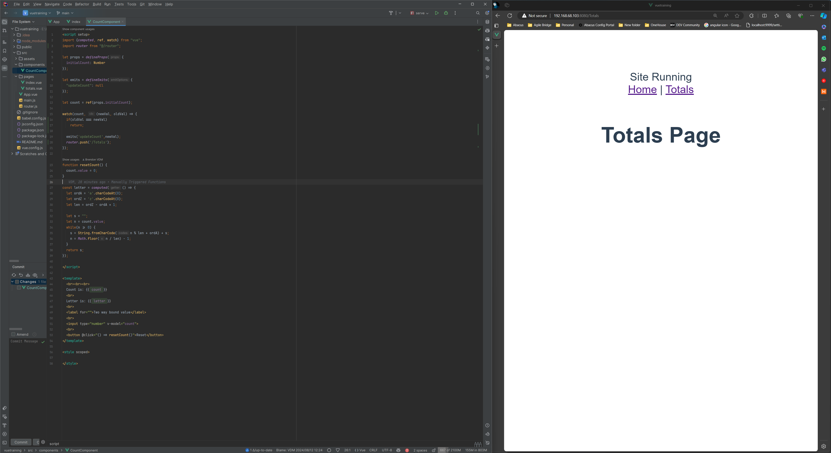
4f. Navigation Through Code

Slide 27
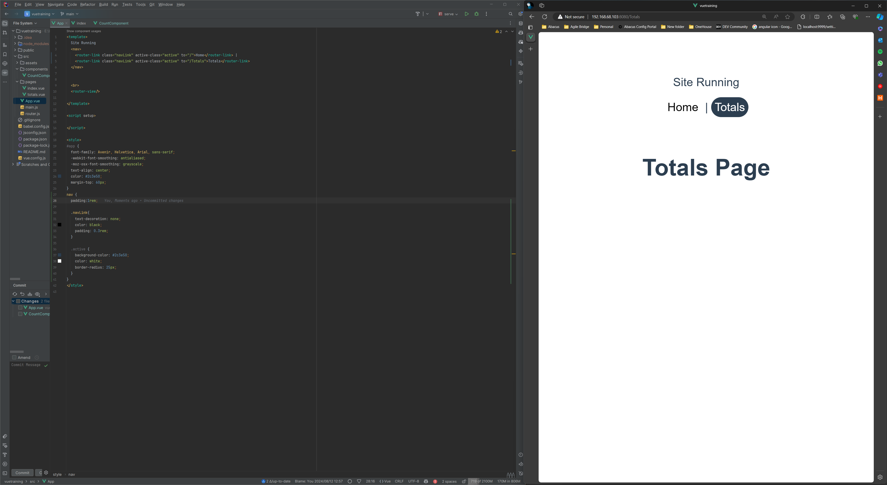
4g. Highlighting Active Page

Slide 28
Global Storage

Slide 29
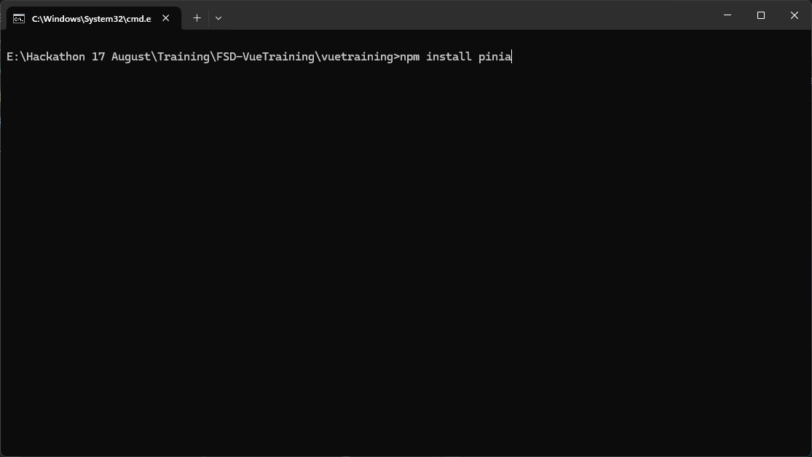
5a. Installing a store (Pinia)

Slide 30
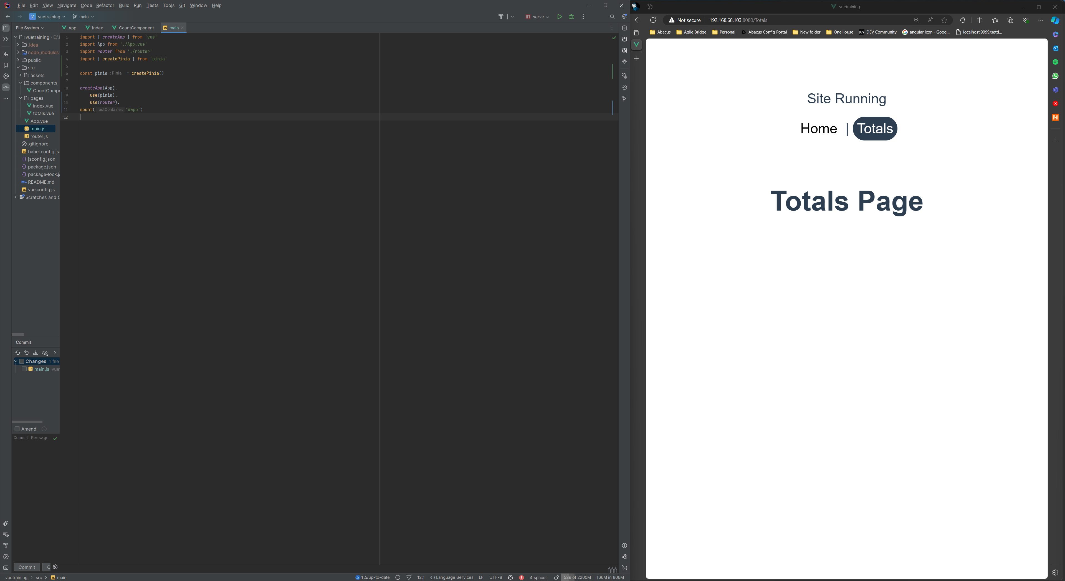
5b. Setting Up Pinia

Slide 31
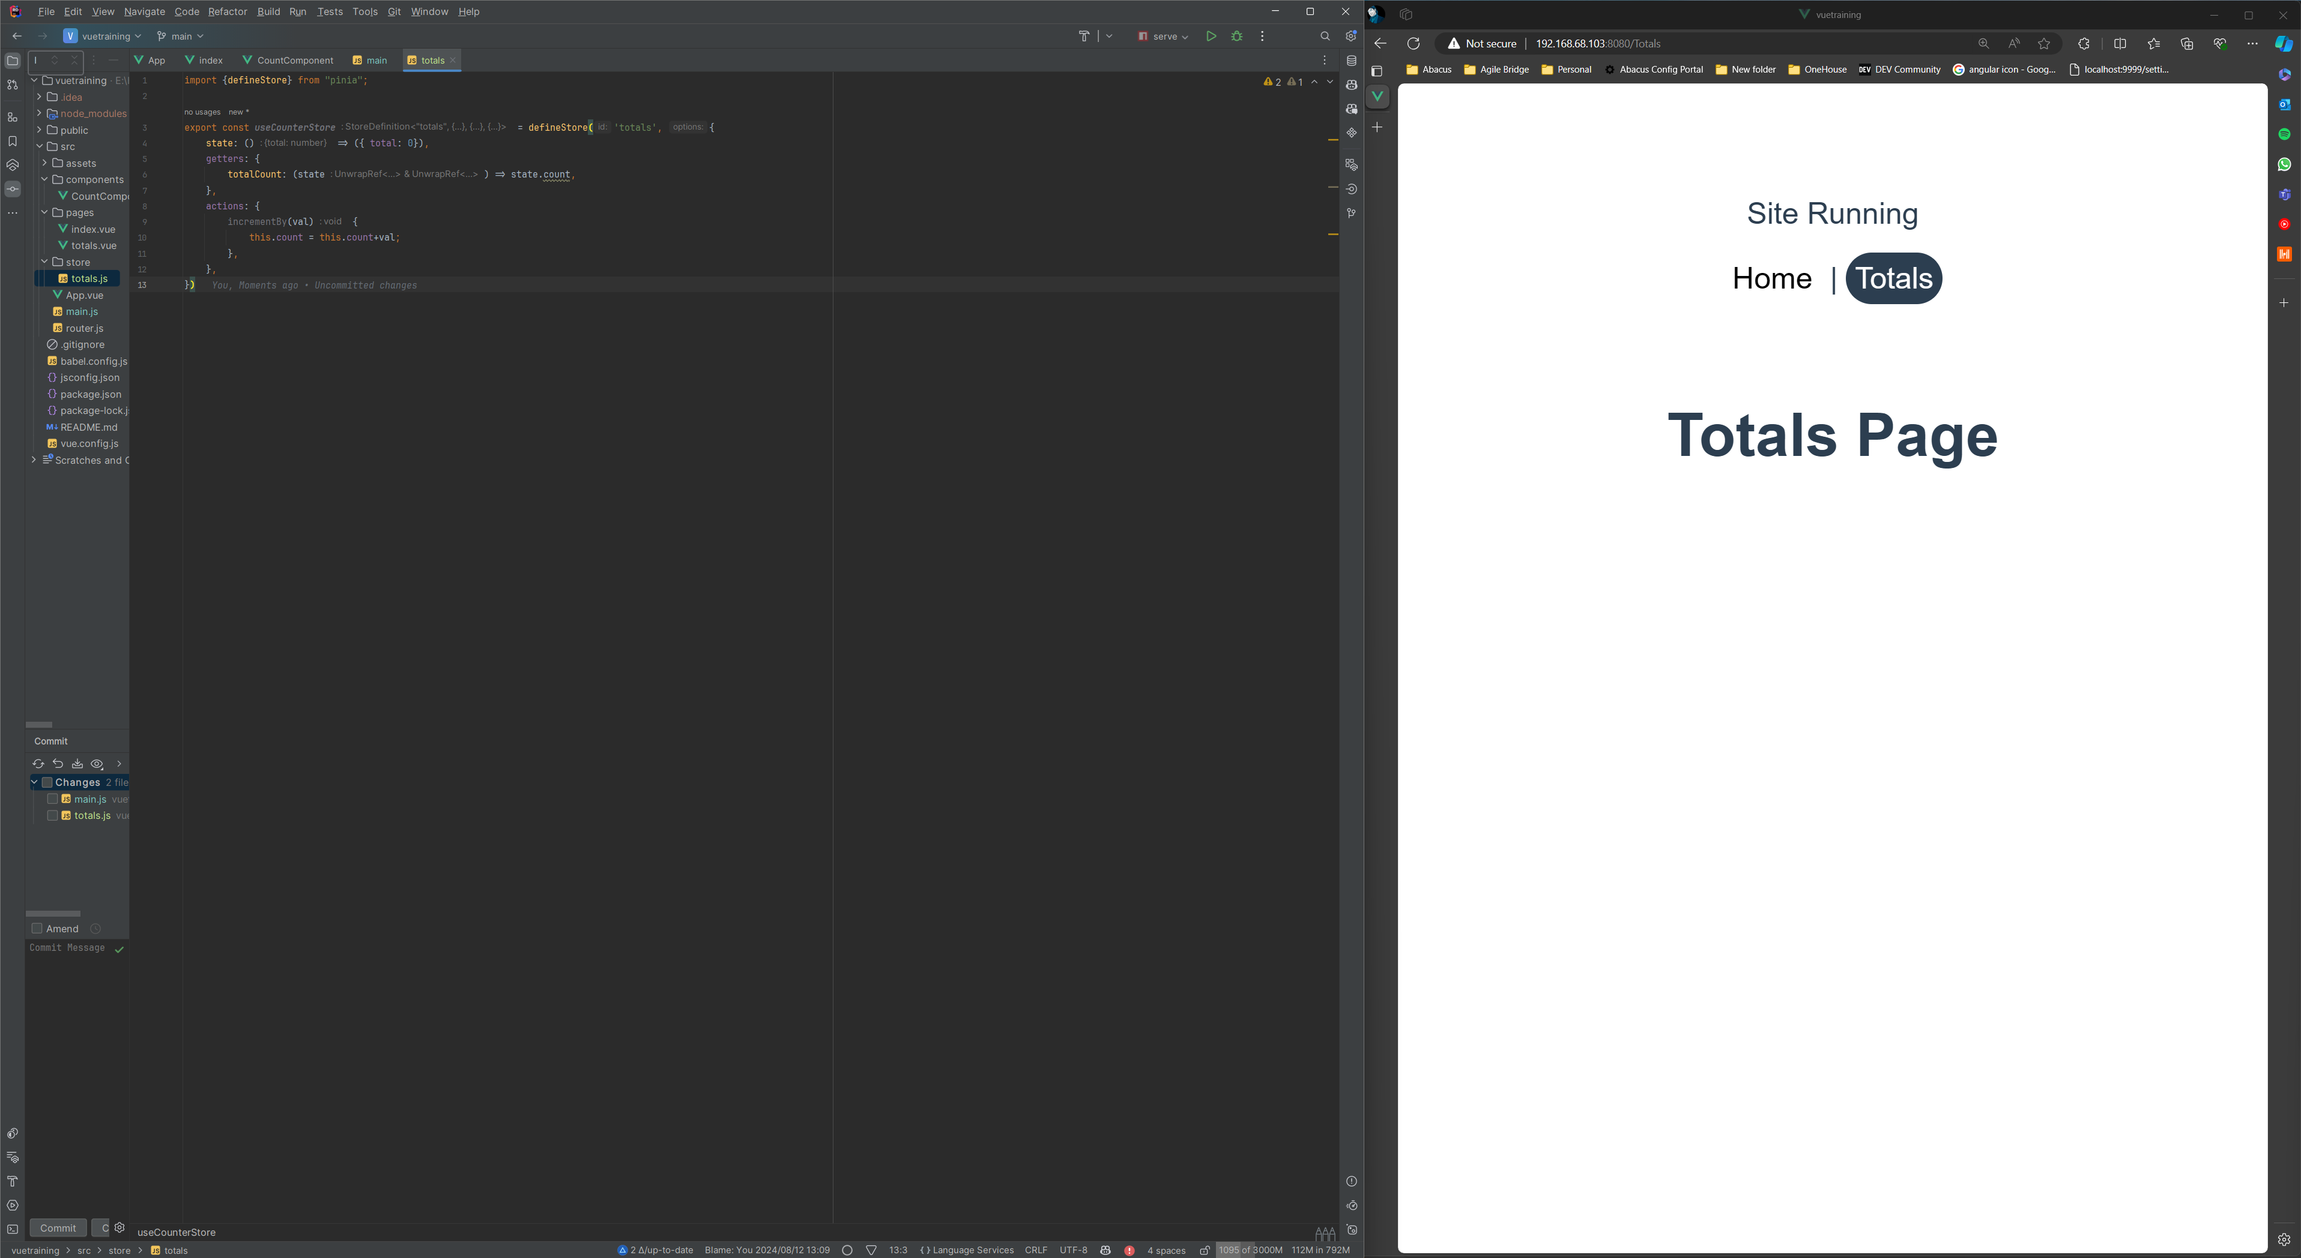
5c. Defining a store

Slide 32
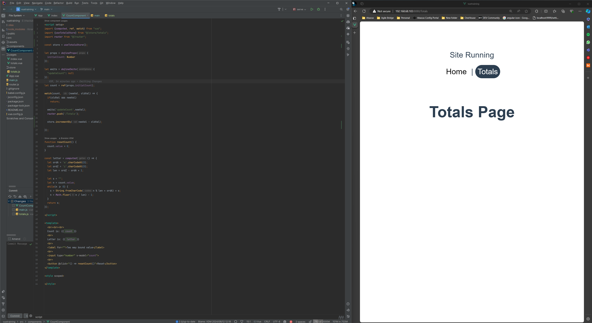
5d. Updating The Store Values

Slide 33
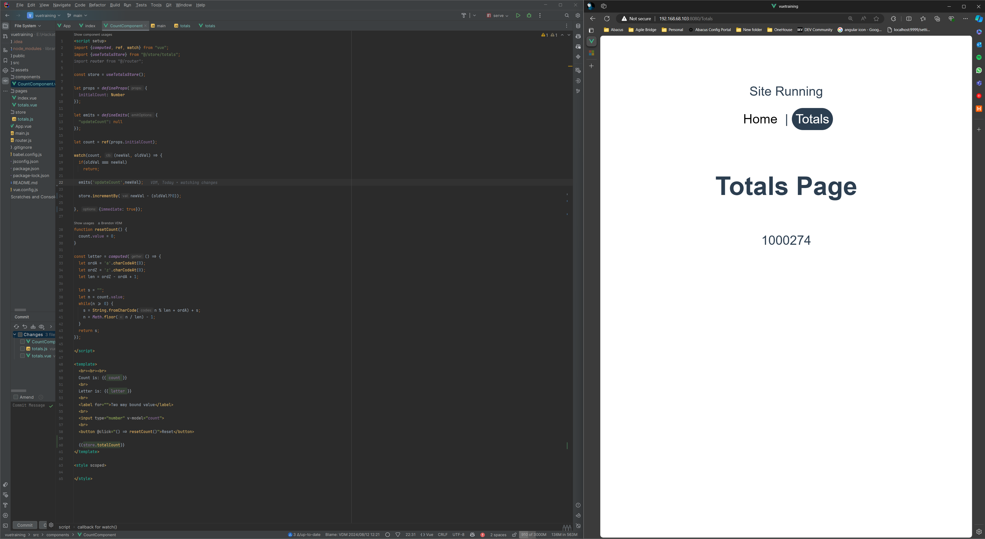
5e. Displaying store values

